Slide 1

E-commence Data Analysis
Future Data Analysts
PrideNgomane/E-commence-Data-Analysis

Slide 2


Introduction to Web-Scraping Presentation
Tools used
Libraries Used
- BeautifulSoup
- Request and Json
- Pandas
- Matplotlib and Seaborn
-Numpy
Anaconda (Jupiter Notebook)

Slide 3

Phase 1: Web Scraping
1. What is Web-Scraping?
2. Why Web-Scraping?
3. Selected data to analyze
Title
Price
Rating
Availability
Review counts
4. Tools and Technologies
Requests: Fetches HTML content.
BeautifulSoup: Parses and extracts data

Slide 4
Phase 2: Data Cleaning using Pandas lib
Removing missing or duplicate data.
Converting price column to numerical values.
Normalizing ratings.
Handle outliers.

Slide 5
Codes for Standardizing and Cleaning our Data
df.isnull()
df.duplicated()
df["ratings"] = df["Review count"].astype(str).str.extract(r"(\d+)").astype(int)
df.drop(columns = [‘column: 0’])

Slide 6
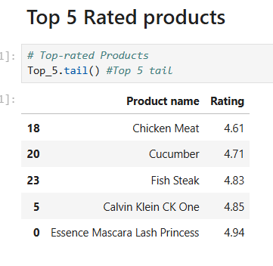
Phase 3: Exploratory Data Analysis
Top-rated products.
Price distribution.
price vs. rating correlation.
Summarize trends
1
2
3
4

Slide 7
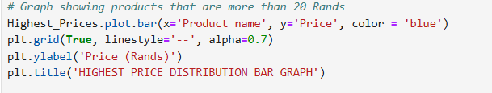
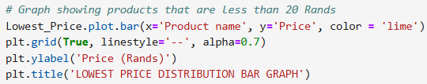
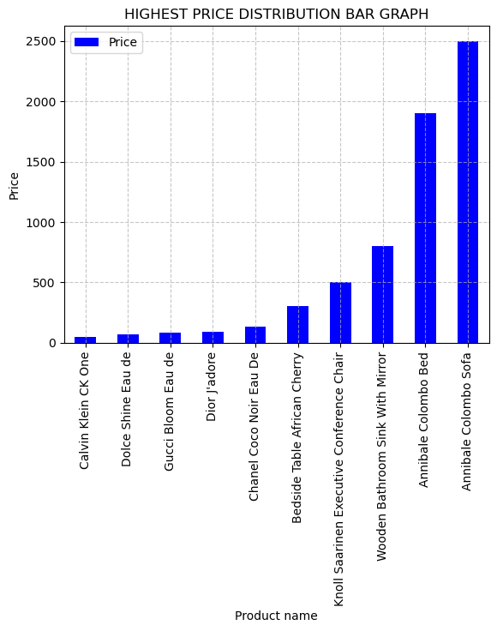
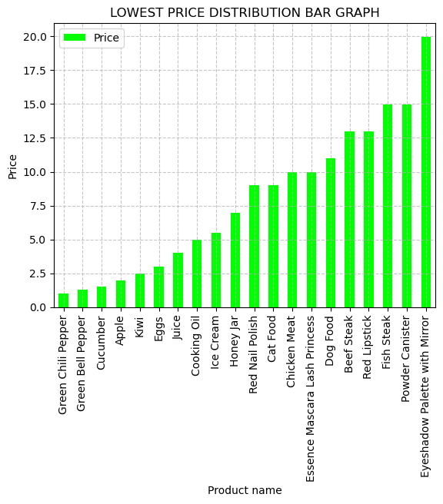

Slide 8
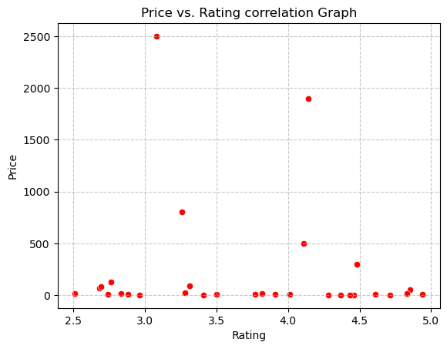
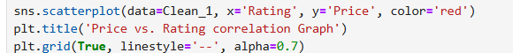
PRICE VS RATING CORRELATION
Annibale colombo sofa
Annibale colombo bed
Wooden bathroom sink with a mirror

Slide 9

Recommendation and Insights
Focus on
High-Value Products
Enhance
Product Quality
Leverage
Customer Feedback
Optimize
Pricing Strategy
Improve
Shipment Duration

Slide 10

Conclusion
Implementing these insights and recommendations will enhance market positioning, improve customer satisfaction, and drive sales growth in the e-commerce landscape.

Slide 11

Thank you….

